Slide 1

Team 12

Slide 2
Model Architecture
LSTM
Long Term Close Price
10 Years of Stock Data
Stock-oriented NLP model
Random Forest
Continuous Daily Close Price

Slide 3
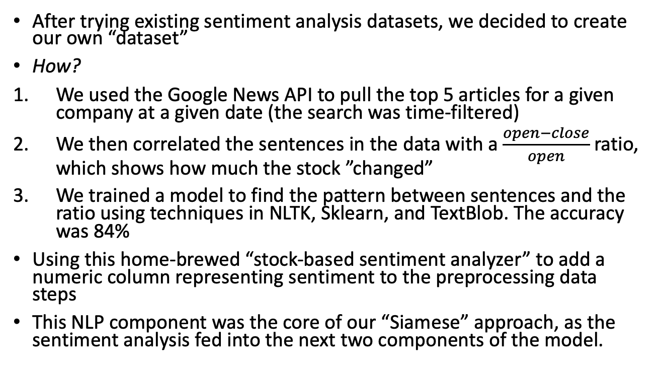
Natural Language Processing (NLP)
After trying existing sentiment analysis datasets, we decided to create our own “dataset”
How?
We used the Google News API to pull the top 5 articles for a given company at a given date (the search was time-filtered)
We then correlated the sentences in the data with a $\frac{open−close}{open}$ratio, which shows how much the stock ”changed”
We trained a model to find the pattern between sentences and the ratio using techniques in NLTK, Sklearn, and TextBlob. The accuracy was 84%
Using this home-brewed “stock-based sentiment analyzer” to add a numeric column representing sentiment to the preprocessing data steps
This NLP component was the core of our “Siamese” approach, as the sentiment analysis fed into the next two components of the model.

Slide 4
Random Forest (RF)
The Random Forest algorithm is used for short term trading.
The model can predict next day closing prices with an R² of 0.938, but only in a short-term, day-by-day context
It integrates with the long-term LSTM’s closing price predictions, the results from the NLP analysis, and historical data
This approach balances the weaknesses of each model
It can be implemented for minute by minute trading, and it could have real-time synchronization with Google News for speedy updated predictions

Slide 5
Long Short Term Memory (LSTM)
The LSTM is used for long term prediction.
It takes input from the Random Forest algorithm and the NLP sentiment analysis algorithm along with the original data set.
This neural net keeps track of historical trends as well as short term trends to make a viable long term prediction model.
The NLP and RF algorithms are used to improve the short term accuracy of the model to handle things like negative press and general market trends

Slide 6
Business Thesis
Our algorithm can be used for BOTH short term and longer term trading
It also posses the ability to update predictions in real-time as the week, month, or year goes on
Since our product is versatile, each option could be viable. However, in a general sense, 3M is the best option because the Random Forest was the most accurate for them. We believe that the higher accuracy is the most important factor in determining the investment, because then we can be confident in what will happen to our investment.

Slide 7
Data Visualization

Slide 8
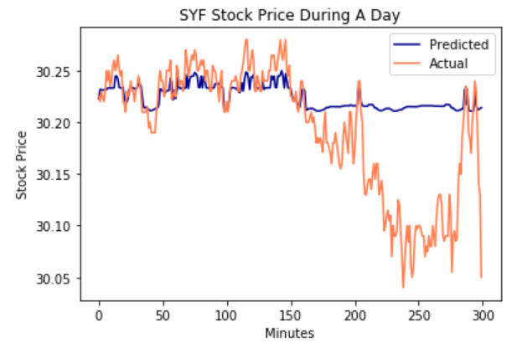
Data Visualization RF - SYF

Slide 9
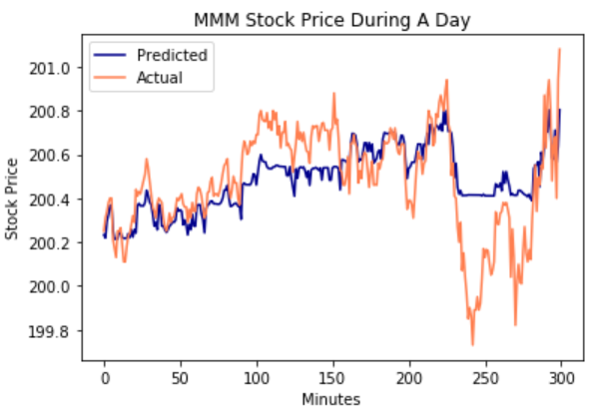
Data Visualization RF - MMM

Slide 10
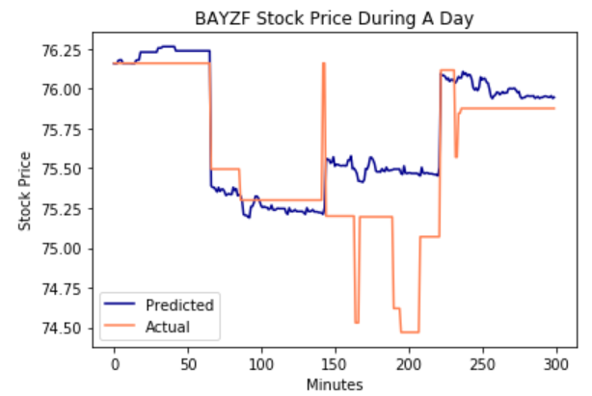
Data Visualization RF - BAYZF

Slide 11
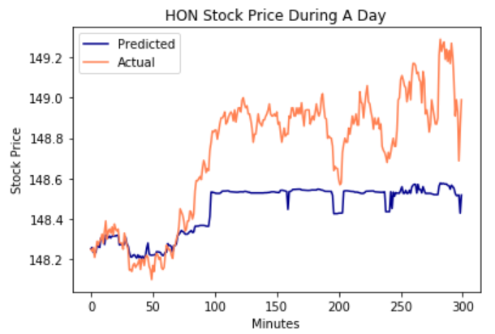
Data Visualization RF - HON

Slide 12
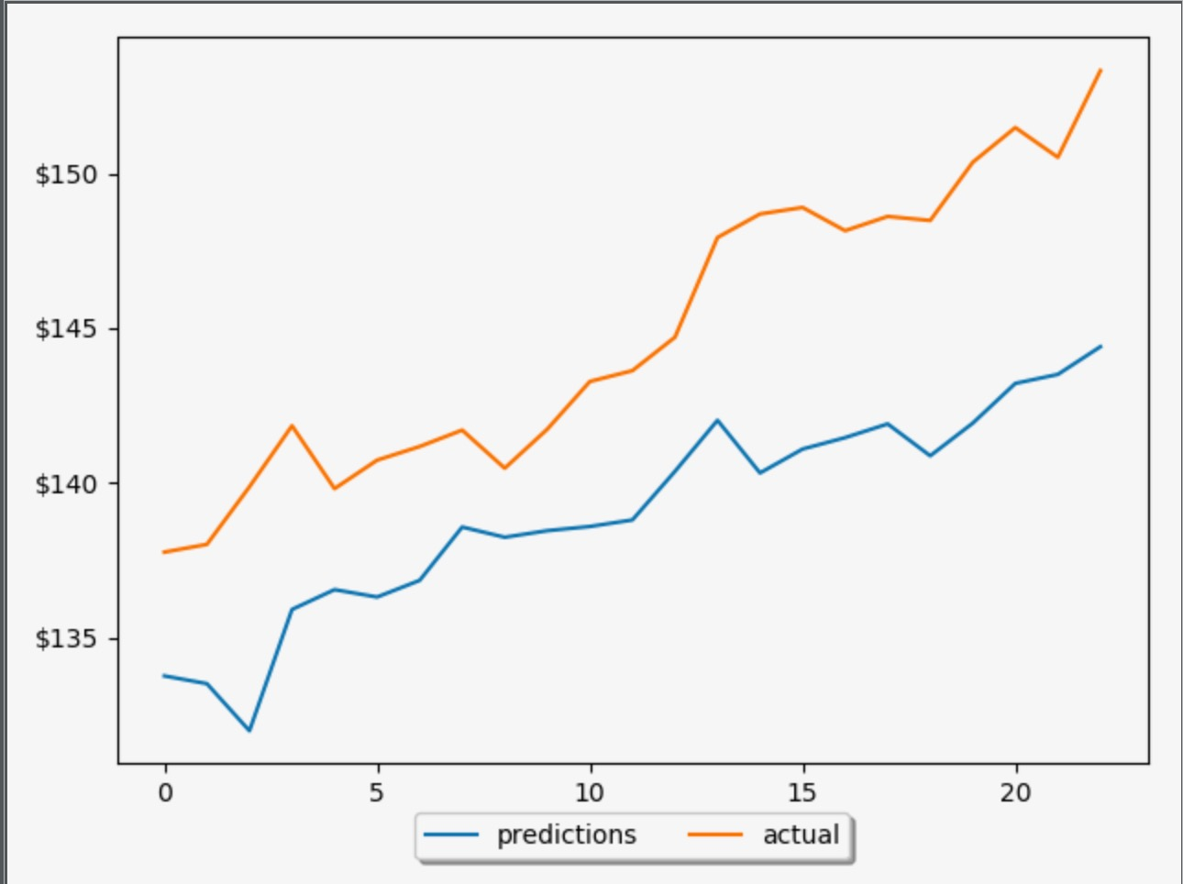
Data Visualization LSTM - HON
Prediction 10 days in advance

